Slide 1

Operations Research
Special Cases of Linear Programming
Amjad Ali

Slide 2
References
“Introduction to Operations Research” by Frederick S. Hillier
“Operations Research: An Introduction“ by Hamdy A. Taha
Video Lectures by Prof G. Srinivasan, IIT Madras

Slide 3
Linear Programming
Special Cases of Linear Programming
Alternative Optima
Unbounded Solution
Infeasible Solution
Degeneracy

Slide 4
Linear Programming
Special Cases of Linear Programming
1. Degeneracy
2. Alternative Optima
3. Unbounded Solution
4. Infeasible Solution

Slide 5
UNBOUNDED SOLUTION -
Special Case of Linear Programming
EXAMPLE: Solve the following LP Model
Max Z = 2 x₁ + x₂
Subject to
x₁ - x₂ ≤ 10
2 x₁ ≤ 40
x₁, x₂ ≥ 0

Slide 6
INFEASIBLE SOLUTION -
Special Case of Linear Programming
Pivot Column
Max Z = 2 x₁ + x₂
Subject to
x₁ - x₂ ≤ 10
2 x₁ ≤ 40
x₁, x₂ ≥ 0
Basic
x₁ x₂ s₁ s₂ Sol
Ratio
Z
-2 -1 0 0
0
s₁
1 -1 1 0
10
10/1 = 10
s₂
2 0 0 1
40
40/2 = 20
Z
0 -3 2 0
20
Z - 2 x₁ - x₂ = 0
Subject to
x₁ - x₂ + s₁ = 10
2 x₁ + s₂ = 40
x₁, x₂, s₁, s₂ ≥ 0
x₁
1 -1 1 0
10
-
s₂
0 2 -2 1
20
20/2 = 10
Z
0 0 -1 1.5
50
x₁
1 0 0 0.5
20
-
x₂
0 1 -1 0.5
10
-
Solution is Unbounded
Ratio Test Fails

Slide 7
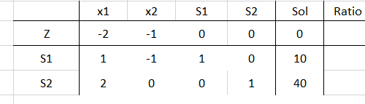
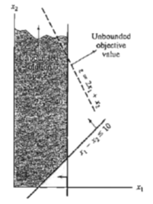
UNBOUNDED SOLUTION -
Special Case of Linear Programming
Max Z = 2 x₁ + x₂
Subject to
x₁ - x₂ ≤ 10
2 x₁ ≤ 40
x₁, x₂ ≥ 0
All constraint coefficient under x2 are negative or zero, meaning that
x2 can be increased indefinitely without violating any of the constraints.
Because each unit increase in x2 will increase z by 1, so an infinite increase in x2 will also result in an infinite increase in z.
Thus, the problem has no bounded solution.

Slide 8
UNBOUNDED SOLUTION -
Special Case of Linear Programming
Max Z = 2 x₁ + x₂
Subject to
x₁ - x₂ ≤ 10
2 x₁ ≤ 40
x₁, x₂ ≥ 0
1. If at any iteration the constraint coefficients of any non-basic variable are negative or zero, then the solution space is unbounded in that direction.
2. If, in addition, the objective coefficient of that variable is negative (in case of maximization) or positive (in case of minimization), then the objective value is also unbounded.

